Slide 1


Customer Churn
Kinjal Botadra

Slide 2

Strive not to be a success, but rather to be of value. Albert Einstein

Slide 3

Agends
What is Customer Churn?
Data Description
Reasons for Customer Churn
Ways to retain Customers
Jupyter Notebook Solution explanation
Summery

Slide 4

Customer Churn
Customer churn is the percentage of customers that stopped using your company's product or service during a certain time frame.
Decreasing the Customer Churn is a key goal for any business. Predicting Customer Churn (also known as Customer Attrition) represents an additional potential revenue source for any business. Customer Churn impacts the cost to the business. Higher Customer Churn leads to loss in revenue and the additional marketing costs involved with replacing those customers with new ones.
In this challenge, as a data scientist of a bank, you are asked to analyze the past data and predict whether the customer will churn or not in the next 6 months. This would help the bank to have the right engagement with customers at the right time.

Slide 5
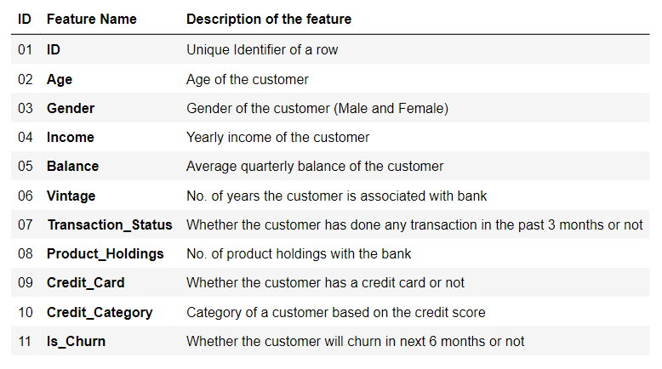

Slide 6
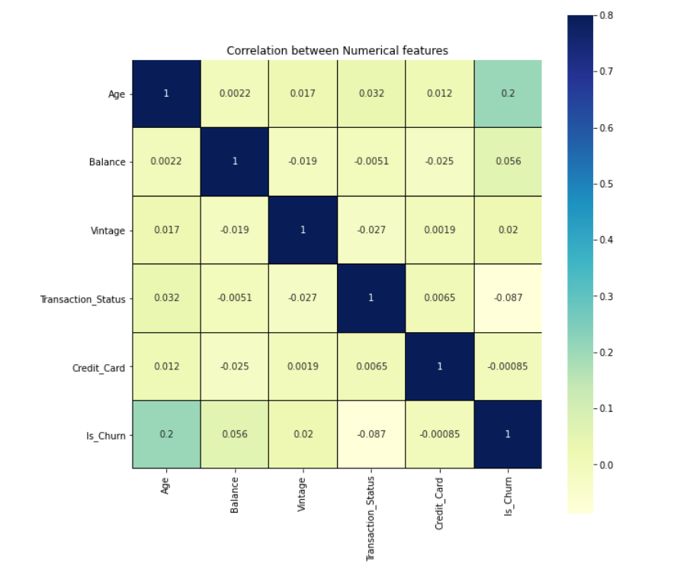
Heat Map
Positively correlated with Is_churn
Age
Balance
Vintage
Negatively correlated with Is_churn
Transaction Status
Credit Card

Slide 7
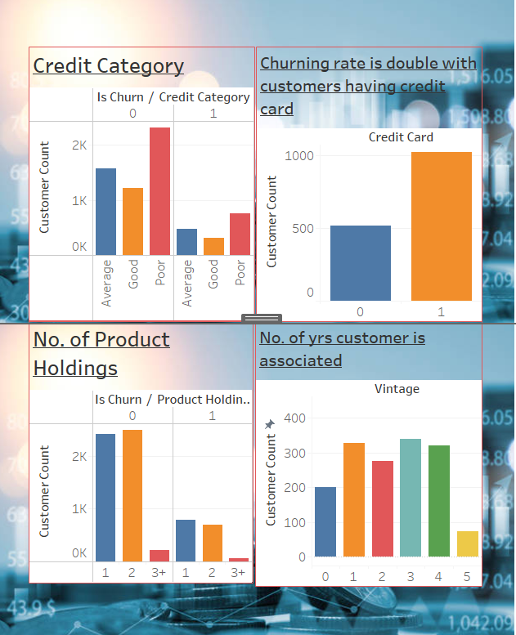

Reasons for Customer Churn
Poor Credit Category
Customer associated with the bank < 5 years
Most of the customers have only max 2 product holdings
Transaction status of a customer for last 3 months

Slide 8
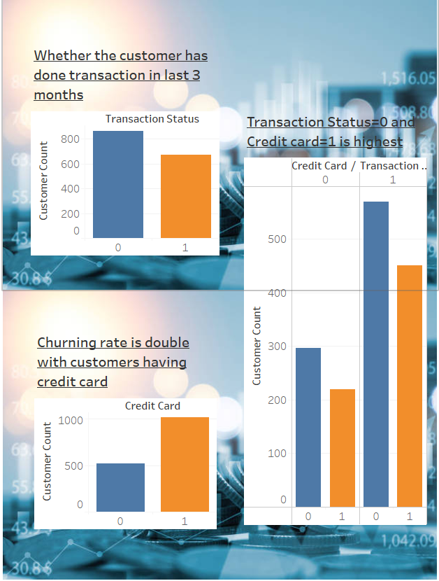

Transaction status and Credit cards
Transaction status(TS) is whether the customer has done any transaction in last 3 months
TS is higher for customers who haven’t done any transaction in last 3 months
Customers with credit cards have high churn rate
Credit card expires every 3 years
Competitors provided better perks

Slide 9

Ways of retaining customers
Maximising Product holdings
Your product is a tool to help them get faster success
Add more features compared to your competitors
Regular feedback driven customer service
Competitive rates on long-term
Higher profit investment vehicles
Online and mobile experiences are smooth, easy, secure, and enjoyable

Slide 10

Jupyter Notebook Explanation

Slide 11
Data Processing
One – Hot Encoding for Categorical fields
Gender
Income
Credit_Category
Product_Holdings

Slide 12
Data Modeling
Algorithms tried and their macro F1 scores on training data:
Logistic Regression
DecisionTree : 0.47
GaussianNB: 0.43
Random Forest: 0.43
KNN: 0.46
XGBClassifier: 0.51

Slide 13

Conclusion
XGBoost model was used for model evaluation and prediction as it gave the best macro F1 score
Macro F1 Score was used to arrive at model evaluation which is required for this Project
One-Hot Encoding using one hot encoder was used
StandardScaler scaling provided best Macro F1 Score for this dataset as most of numeric feature did not have normal distribution and contains outliers

Slide 14
Summary
Customer churn issue is faced by all the banks
Now a days there a tough competition among all the banks
To have a upper hand banks need to:
Regular feedbacks from the customers
Retaining customers by issuing new credit cards before their expiration
Giving the best features in the products and convincing customers to take more than 2 products
Best online user experience

Slide 15
Thank you

